Slide 1
Machine Learning
Machine Learning Introduction

Slide 2
Machine Learning Introduction
Math & Statistics
Machine learning is a field of computer science that gives computer systems the ability to "learn" with data, without being explicitly programmed. The name Machine learning was coined in 1959 by Arthur Samuel.
Computer Science
Subject Matter Expertise
Traditional Software
Traditional Research
Unicorn
Machine Learning
Notes:
Unicorn means something that is highly desirable but difficult to find or obtain.

Slide 3
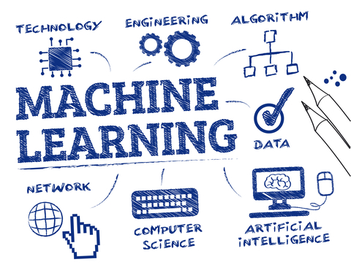
Machine Learning Introduction
ML is a system which can do automatic acquisition and integration of knowledge.
It is that branch of artificial intelligence that deals with the construction of systems that can learn from data
Develop methods that can automatically detect patterns in data, and then to use these patterns to predict future data
Machine learning can predict
the future based on the past
Computer programs that
automatically improve their
performance through experience

Slide 4
How Does Machine Learning Work?
Notes:
Unicorn means something that is highly desirable but difficult to find or obtain.

Slide 5
Why Machine Learning?
Automatically adapt and customize to individual users.
Personalized news, mail filters, movie/book recommendation
Discover new knowledge from huge amount of data
Market analysis
Perform repetitive monotonous tasks of humans which require intelligence and experience
Recognize signatures or handwritten characters
Driving a car, flying a plane
Rapidly changing phenomenon
Credit scoring, financial modeling, diagnosis, fraud detection
No human experts industrial/manufacturing control, mass spectrometer analysis, drug design

Slide 6
Machine Learning
Concepts & Dimensions of Machine Learning

Slide 7
Concepts of Learning
Learning = Improve Task “T” with respect to performance measure “P” based on experience “E”
Example: Spam Filtering
T: Identify Spam emails
P: % of Spam emails filtered correctly, % of non-Spam emails that were filtered incorrectly (false positives)
E: Database of emails labelled manually by users
A checkers learning problem:
Task T: playing checkers
Performance measure P: percent of games won against opponents
Training experience E: playing practice games against itself
We can specify many learning problems in this fashion, such as learning to recognize handwritten words, or learning to drive a robotic automobile autonomously

Slide 8
Concepts of Learning
Example: Signature matching
T: Determine if signature belongs to correct person
P: % of signatures that were correctly matched, % of valid signatures that were incorrectly labelled as not matching
E: Database of signatures known to be of that person

Slide 9
Dimensions Of Learning Systems
What is Dimension of Learning?
Dimensions of Learning is a comprehensive model that uses what researchers and theorists know about learning to define the learning process. There are five types of thinking – what we call the five dimensions of learning- are essential to successful learning.
Dimension 1: Attitudes and Perceptions
Attitudes and perceptions affect students’ abilities to learn. For example, if students view the classroom as an unsafe and disorderly place, they will likely learn little there.

Slide 10
Dimensions Of Learning Systems
Dimension 2: Acquire and Integrate Knowledge
When students are learning new information, they must be guided in relating the new knowledge to what they already know, organising that information, and then making it part of their long-term memory.
Dimension 3: Extend and Refine Knowledge
Learning does not stop with acquiring and integrating knowledge. Learners develop in-depth understanding through the process of extending and refining their knowledge

Slide 11
Dimensions Of Learning Systems
Dimension 4: Use Knowledge Meaningfully
The most effective learning occurs when we use knowledge to perform meaningful tasks. For example, we might initially learn about tennis rackets by talking to a friend or reading a magazine article about them.
Dimension 5: Habits of Mind
The most effective learners have developed powerful habits of mind that enable them to think critically, think creatively, and regulate their behaviour.

Slide 12
Machine Learning
The Learning Process

Slide 13
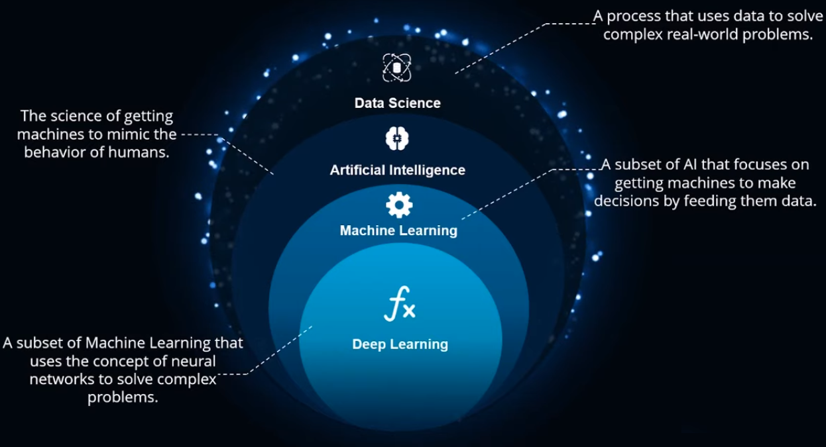
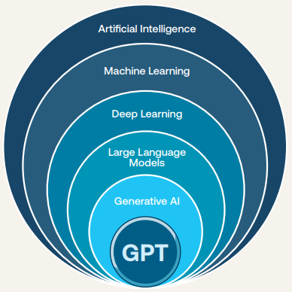

Slide 14
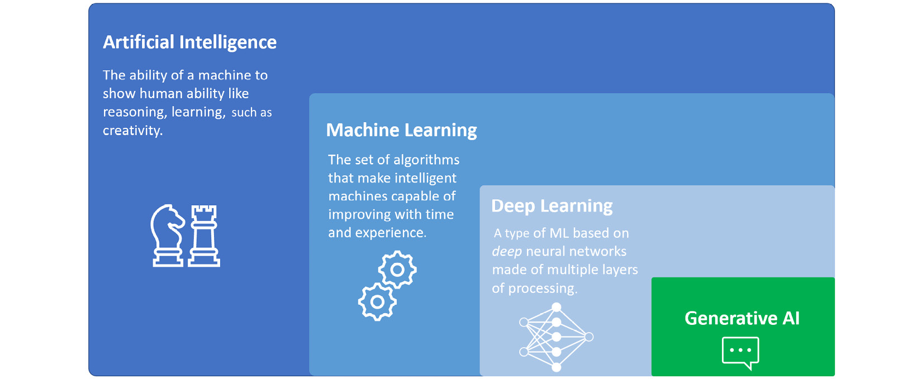
In recent years, generative AI has made significant advancements and has expanded its applications to a wide range of domains, such as art, music, fashion, architecture, and many more. In some of them, it is indeed transforming the way we create, design, and understand the world around us. In others, it is improving and making existing processes and operations more efficient.
The fact that generative AI is used in many domains also implies that its models can deal with different kinds of data, from natural language to audio or images. Let us understand how generative AI models address different types of data and domains.

Slide 15
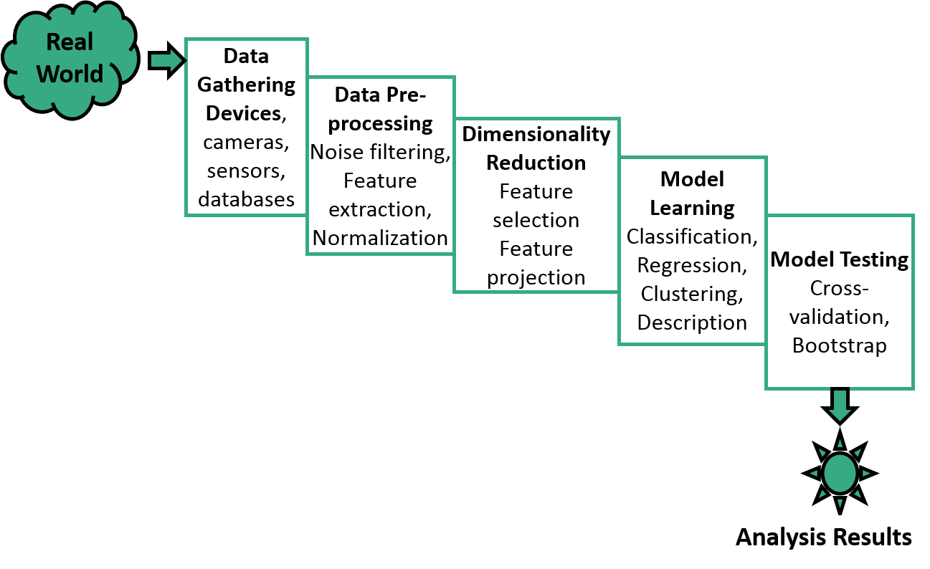
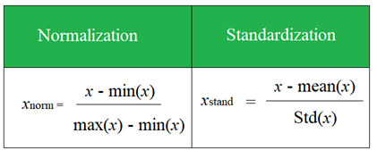
The learning Process
Normalization is used when the data doesn't have Gaussian distribution whereas Standardization is used on data having Gaussian distribution.
Normalization scales in a range of [0, 1] or [-1, 1]. Standardization is not bounded by range.
Normalization is highly affected by outliers. Standardization is slightly affected by outliers.
Normalization is considered when the algorithms do not make assumptions about the data distribution. Standardization is used when algorithms make assumptions about the data distribution.

Slide 16
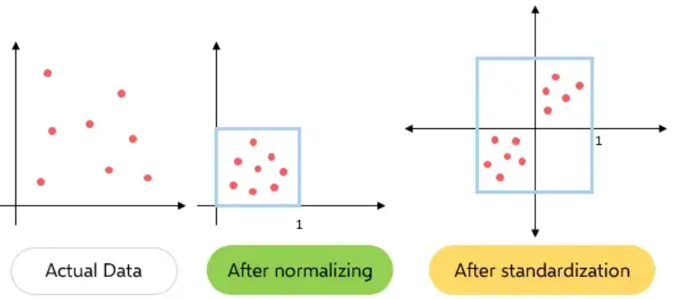
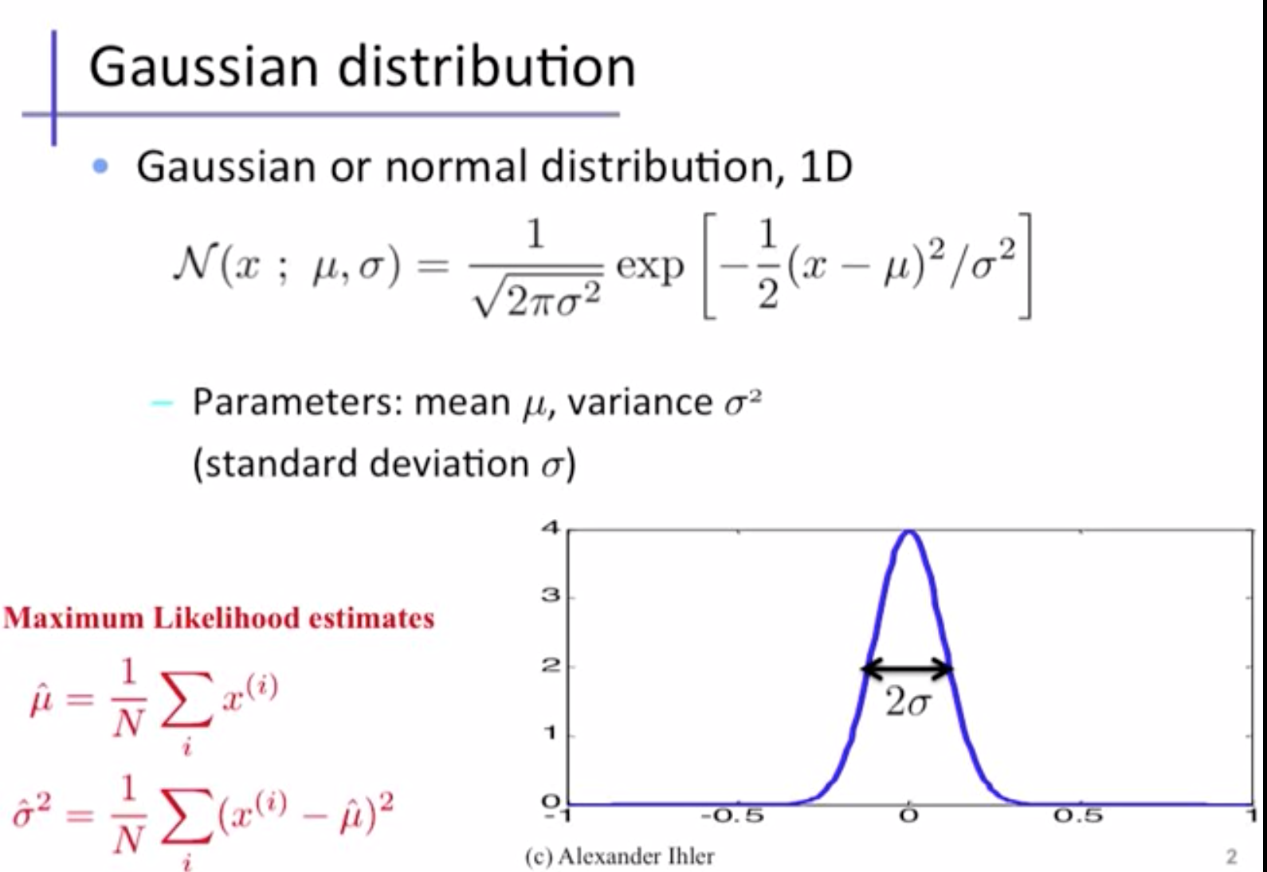
The learning Process
Normalization is used when the data doesn't have Gaussian distribution whereas Standardization is used on data having Gaussian distribution.
Normalization scales in a range of [0, 1] or [-1, 1]. Standardization is not bounded by range.
Normalization is highly affected by outliers. Standardization is slightly affected by outliers.
Normalization is considered when the algorithms do not make assumptions about the data distribution. Standardization is used when algorithms make assumptions about the data distribution.

Slide 17
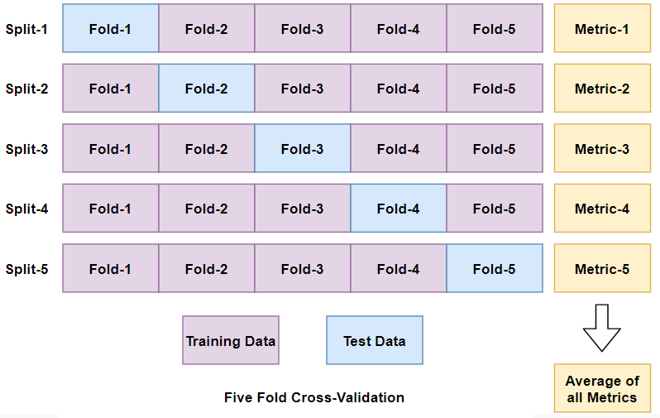
The learning Process
Bootstrap aggregating, also called bagging, is a machine learning ensemble meta-algorithm designed to improve the stability and accuracy of machine learning algorithms used in statistical classification and regression.

Slide 18
Bagging
Bagging attempts to reduce the chance overfitting complex models.
It trains a large number of "strong" learners in parallel.
A strong learner is a model that's relatively unconstrained.
Bagging then combines all the strong learners together in order to "smooth out" their predictions.
Example – Random Forest Classifier.
Boosting
Boosting attempts to improve the predictive flexibility of simple models.
It trains a large number of "weak" learners in sequence.
A weak learner is a constrained model (i.e., you could limit the max depth of each decision tree).
Each one in the sequence focuses on learning from the mistakes of the one before it.
Boosting then combines all the weak learners into a single strong learner.
Example – Boosted Tree Classifier
The learning Process
Bootstrap aggregating, also called bagging, is a machine learning ensemble meta-algorithm designed to improve the stability and accuracy of machine learning algorithms used in statistical classification and regression.

Slide 19
Hyper Parameters and Model Parameters
What are Hyper Parameters?
So far, we’ve been casually talking about “tuning” models. When we talk of tuning models, we specifically mean tuning hyper-parameters.
There are two types of parameters in machine learning algorithms. The key distinction is that model parameters can be learned directly from the training data while hyper-parameters cannot. Hyper-parameters express “higher-level” structural settings for algorithms. They are decided before fitting the model because they can’t be learned from the data.
As Example: Strength of the penalty used in Regularized Regression
As Example: The number of trees to include in a Random Forest
What are Model Parameters?
Model parameters are learned attributes that define individual models. They can be learned directly from the training data.
As Example: Regression coefficients
As Example: Decision Tree split locations
Notes:
19

Slide 20
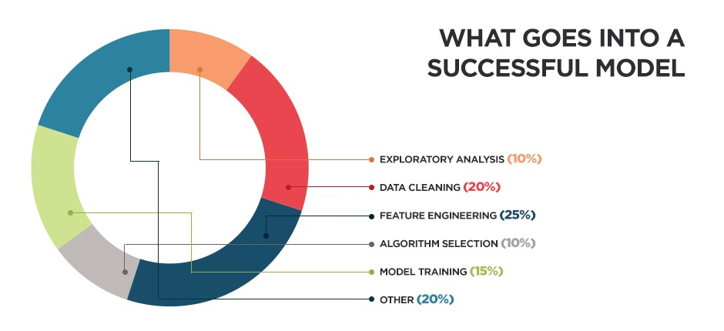

Slide 21
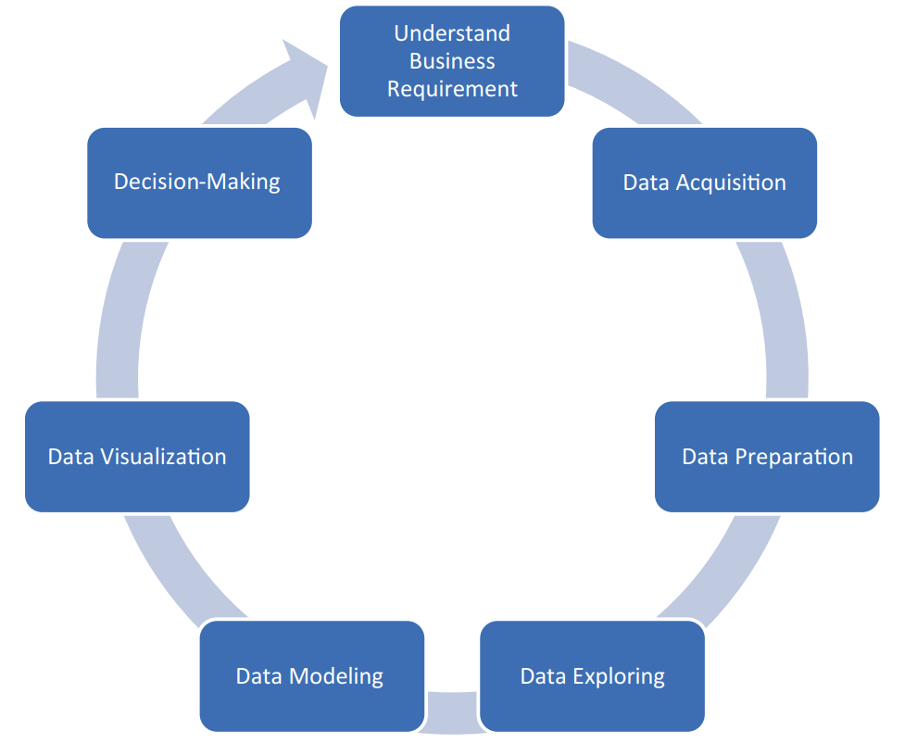


Slide 22
Machine Learning Steps
Training Data
(past)
Learn
Model
Testing Data
(future)
Model
Predict
Steps:
Gather Data from various sources
Clean data to have homogeneity
Build model (select the right Machine Learning algorithm)
Gather insights from the model’s results
Visualize – transform results into visual graphs

Slide 23
Performance Evaluation
Randomly split examples into training set U and also test set V.
Use training set to learn a hypothesis H.
Measure % of V correctly classified by H.
Repeat for different random splits and average results.

Slide 24
Problems - Overfitting & Underfitting
Overfitting – the model learns the training set too well. It overfits to the training set and performs poorly on the test set
Underfitting – when the model is too simple, both training and test errors are large

Slide 25
Machine Learning
Categorization of Machine Learning

Slide 26
Categorization of Machine Learning
Machine Learning
Supervised
Unsupervised
Reinforcement
Task Driven, labelled (Regression/Classification).
Input variables X and output variable y. y = f(X).
Algorithm learns from training data set. Iteratively make predictions which are corrected (teaching).
Learning stops when performance reaches acceptable level.
Data Driven, unlabeled (Clustering)
No correct answers, no teacher, no labelling
Algorithm looks for patterns in data.
Reward feedback based
Algorithm learns to react to an environment. Automatically determine ideal behavior within a context.

Slide 27
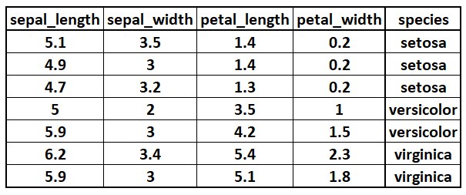

Data Set for Supervised Learning

Slide 28
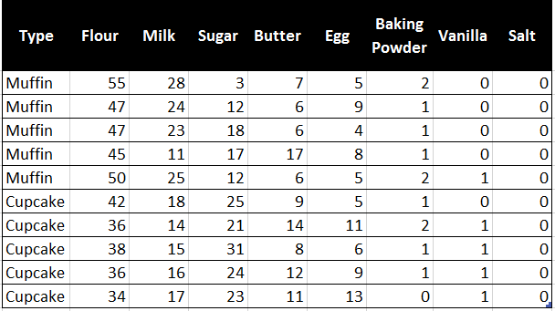


Data Set for Supervised Learning
The most obvious visual difference between cupcakes and muffins is, of course, the frosting. Cupcakes are topped with creamy, delicious frosting. Instead, muffins may have a sugared top or a very thin glaze. Usually the fillings inside the muffins add enough excitement to the baked good, so there might not be anything on top.

Slide 29
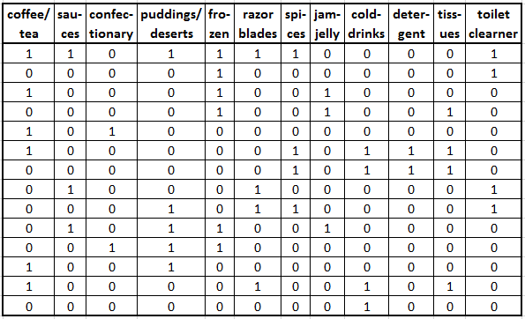
Data Set for Unsupervised Learning

Slide 30
Machine Learning Coordinates
Supervised Learning
Unsupervised Learning
Classification or Categorization
Clustering
Discrete
Regression
Dimensionality Reduction
Continuous

Slide 31
Machine Learning Coordinates
Supervised Learning
Unsupervised Learning
Classification or Categorization
Clustering
Discrete
Regression
Dimensionality Reduction
Continuous
In statistics, machine learning, and information theory, dimensionality reduction or dimension reduction is the process of reducing the number of random variables under consideration by obtaining a set of principal variables. It can be divided into feature selection and feature extraction

Slide 32
Classification & Clustering
Classification is the problem of identifying to which of a set of categories (classes) a new observation belongs, on the basis of a training set of data containing observations (or instances) whose category membership is known.
Classification is considered an instance of supervised learning, i.e. learning where a training set of correctly identified observations are available.
The corresponding unsupervised procedure is known as clustering, and involves grouping data into categories based on a measure of similarity or distance.

Slide 33
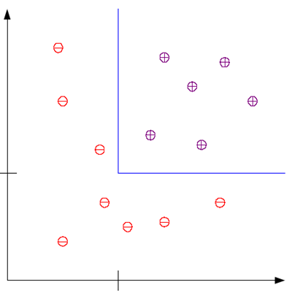


Classification & Clustering
Example: This is an example of a classification problem where there are two classes: low-risk and high-risk customers. The information about a customer makes up the input to the classifier whose task is to assign the input to one of the two classes. After training with the past data, a classification rule learned may be of the form
Low-Risk
Savings
IF Income > Ѳ1 AND Savings > Ѳ2 THEN
Low-Risk
ELSE
High-Risk
$$θ_{2}$$
High-Risk
$$θ_{1}$$
Income

Slide 34
Regression
A regression problem is when the output variable is a real value, such as “dollars” or “weight” instead of a class.
Estimate the relationship between a dependent variable and one or more independent variables (or 'predictors’)
Sales figures for a television model can depend on several factors like screen size, display type, brand, resolution, technology etc.
Here, we consider just one attribute, screen size and plot the corresponding prices
x: screen size
y: sales figures
We try to find the relation (function) that best matches these values
x
y‘ = w₀ + w₁x₁
x
x
x
x
y: sales figures
x
x
x
X: screen size

Slide 35
Dimensionality Reduction
Dimensionality reduction is the process of reducing the number of random variables under consideration by obtaining a set of principal variables. It can be divided into feature selection and feature extraction.
Feature selection approaches try to find a subset of the original variables (also called features or attributes). It is about choosing some of features based on some statistical score.
Feature extraction transforms the data in the high-dimensional space to a space of fewer dimensions. It is using techniques to extract some second layer information from the data e.g. interesting frequencies of a signal using Fourier transform.
Dimensionality reduction helps in data compression, reduces computation time and removes redundant features.

Slide 36
Machine Learning
Machine Learning Applications

Slide 37
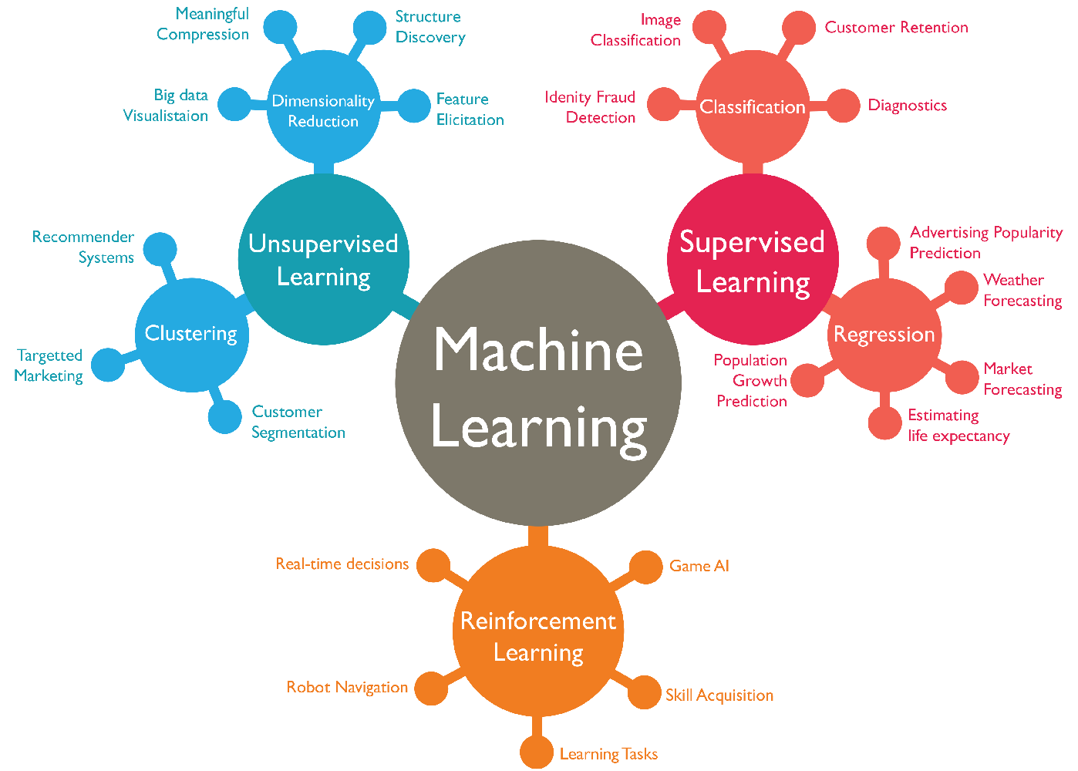
Applications of Machine Learning

Slide 38
Classification Applications
Face Recognition
Identify or verify a person from a digital image or a video frame
Character Recognition
Spam detection
Medical Diagnosis
Determine which disease or condition explains a person's symptoms and signs.
Biometrics
Authentication using physical and/or behavioral characteristics: Face, iris, signature, etc

Slide 39
Regression Applications
Economics/Finance: predict the value of a stock
Epidemiology
incidence, distribution, and possible control of diseases and other factors relating to health
Car/plane navigation: angle of the steering wheel, acceleration
Temporal trends: weather over time

Slide 40
Manufacturing & Retail Industries
Manufacturing
Predictive maintenance or condition monitoring
Warranty reserve estimation
Demand forecasting
Process optimization
Telematics
Retail
Predictive inventory planning
Recommendation engines
Upsell & cross-channel marketing
Market segmentation & targeting
Customer ROI & lifetime value

Slide 41
Healthcare & Life Science & Travel & Hospitality
Healthcare & Life Science
Alerts & diagnostics from real-time patient data
Disease identification & risk stratification
Patient triage optimization
Proactive health management
Healthcare provider sentiment analysis
Travel & Hospitality
Aircraft scheduling
Dynamic pricing
Social media – consumer feedback & interaction analysis
Customer complaint resolution
Traffic patterns & congestion management

Slide 42
Financial Services & Energy, Feedstock & Utilities
Financial Services
Risk analytics & regulation
Customer Segmentation
Cross-selling & up selling
Sales & marketing Campaign management
Credit Worthiness evaluation
Energy, Feedstock & Utilities
Power usage analytics
Seismic data processing
Carbon emissions and trading
Customer-specific pricing
Smart grid management
Energy demand & supply optimization

Slide 43
Machine Learning
Machine Learning Algorithms

Slide 44
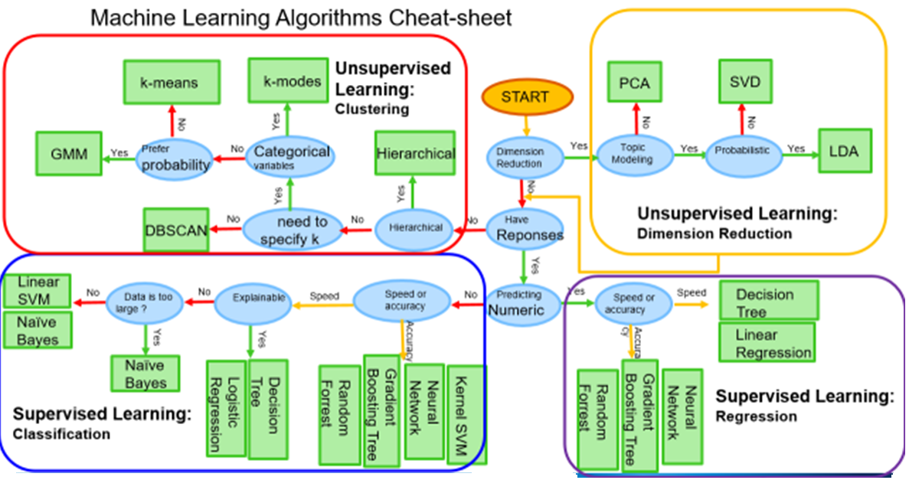
Machine Learning Algorithms
Notes:
Principal Component Analysis. Principal Component Analysis, or PCA for short, is a method for reducing the dimensionality of data. It can be thought of as a projection method where data with m-columns (features) is projected into a subspace with m or fewer columns, whilst retaining the essence of the original data.
Linear Discriminant Analysis (LDA), normal discriminant analysis (NDA), or discriminant function analysis is a generalization of Fisher's linear discriminant, a method used in statistics, pattern recognition and machine learning to find a linear combination of features that characterizes or separates two or more classes of objects or events.
Singular Value Decomposition (SVD) is a matrix factorization method which is used in various domains of science and technology. Furthermore, due to recent great developments of machine learning, data mining and theoretical computer science, SVD has been found to be more and more important
Support Vector Machine (SVM) is a supervised machine learning algorithm which can be used for both classification or regression challenges. However, it is mostly used in classification.

Slide 45
Decision Trees
A decision tree takes as input an object or situation described by a set of properties and outputs a yes/no decision.
Each decision node tests the value of an input attribute.
Branches from the node are all possible values of the attribute
Leaf nodes supply the value (Yes/No) to be returned if that leaf is reached.
Criteria used to choose the best nodes to build the most precise decision tree:
Entropy - degree of disorganization in our data. Entropy is 1 when collection has equal no. of positive and negative examples
Information Gain is used to determine the goodness of a split. The attribute with the most entropy reduction is chosen.

Slide 46
Example: Decision Tree
Decision Tree on whether to buy a Mobile Phone or not
Price of Mobile
<10000
>10000
Size of screen
Technology
<7”
>=7”
Android
IOS
Other
No
Yes
Yes
No
No

Slide 47
Support Vector Machines (SVM)
Y
Support Vectors
X
Map data to higher-dimensional space where they will be linearly separable.
Algorithm - plot each data item as a point in n-dimensional space (where n is number of features) with the value of each feature being the value of a particular coordinate.
Then perform classification into 2 classes by finding the hyper-plane that differentiates the classes very well
Support Vectors are the co-ordinates of the individual observations. Support Vector Machine is a frontier which best segregates the two classes (hyper-plane/ line).

Slide 48
Bayesian Networks
Compute probability distribution for unknown variables given observed values of other variables.
Start with a belief, called a prior
Obtain some data and use it to update the belief. The outcome is called a posterior.
Should we obtain even more data, the old posterior becomes a new prior and the cycle repeats.
Obeys Bayes rule:
P (A | B) = P (B | A) * P( A ) / P( B )
P (A | B) is conditional probability, how likely is A if B happens?

Slide 49
K Nearest Neighbor Model (k-NN)
Idea: Properties of an input x are likely to be similar to those of points in the neighborhood of x
Find (k) nearest neighbor(s) of x and infer target attribute value(s) of x based on corresponding attribute value(s).
In k-NN classification, the output is a class membership. An object is assigned to the class most common among its k nearest neighbors.
In k-NN regression, the output is the property value for the object. This value is the average of the values of its k nearest neighbors.
To determine which of the K instances in the training dataset are most similar to a new input a distance measure is used. There can be various types of distance measures like Euclidean, Hamming, Manhattan etc.

Slide 50
Ensemble Learning
Use multiple models to obtain better predictive performance than could be obtained from any of the individual constituent models
Boosting – incrementally build an ensemble by training each new model instance to emphasize the training instances that previous instances misclassified
Notes:
Ensemble means a group of items viewed as a whole rather than individually.

Slide 51
Deep Learning (Neural Networks)
Subset of machine learning and covers all three paradigms using artificial neural networks (ANNs)
ANNs are composed of multiple nodes that imitate the biological neurons of the human brain
Neurons are connected by links and interact with each other
Nodes can take input data and perform simple operations on the data. They pass the results to other neurons.
The output at each node is called its ”activation value” or ”node value”
Each link is associated with a weight
ANNs “learn” by altering the link weight values
Convolutional neural networks are specialized to read images as input, so are used for image recognition

